Slide 1
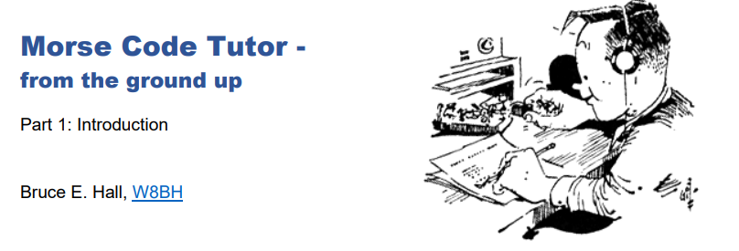
Update to w8BH’s Morse code tutor
Firmware updated by Ve3OOI

Slide 2
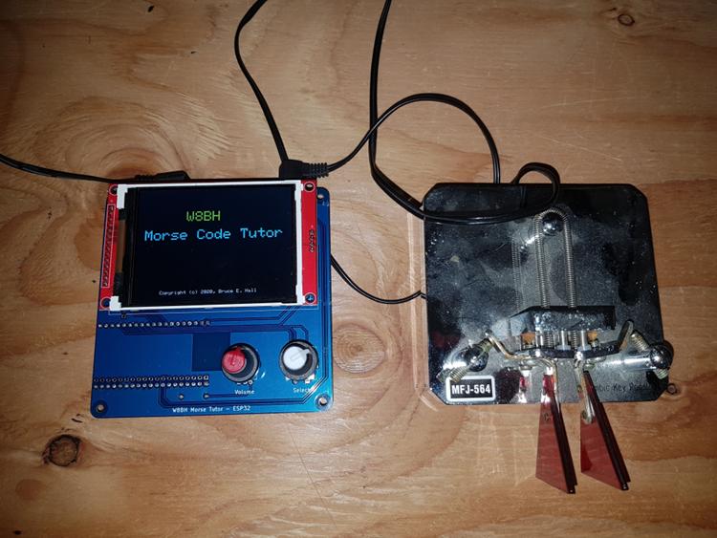
AGENDA
Background
Bruce Hall W9BH Morse Tutor Kits (ESP Version)
Two Way Communication (Current)
ESP-NOW
Proposed Two Way Communication
MQTT

Slide 3

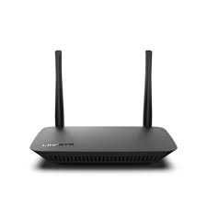
TWO WAY “ADHOC” Communication (AS IS)
Uses ESP_NOW library to perform communications between ESP32 Wi-Fi without an Access Point (i.e. no Wi-Fi Router). This is called ADHOC Network
Limited to a few hundred feet range. i.e. W8BH kits must be close to each other
Current default firmware is good for “classroom” setting. Not suitable for geographic separation (e.g. hundreds of Km away)
See Bruce’s YouTube Video (https://www.youtube.com/watch?v=tp74gO6lAm0)

Slide 4

TWO WAY IP Communication (VE3OOI Firmware)
Based on VE3OOI firmware
Original firmware written by Bruce Hall
Compiled using PlatformIO which is compatible with Arduino IDE. Must use latest IDE and libraries.
Fixed a few issues in the code
Uses MQTT as the underlying messaging
Leverage an internet server to facilitate communications between W8BH kits.
Leverages Free AWS EC2 Linux platform configured for MQTT
W8BH kits must be connected to an Access Point and to the Internet
Must use DHCP to feed gateway address and DNS server to ESP32 Wi-Fi
Each participating W8BH kit MUST use a unique ID.
This is used to identify the station.
Uses a random 3 character string

Slide 5
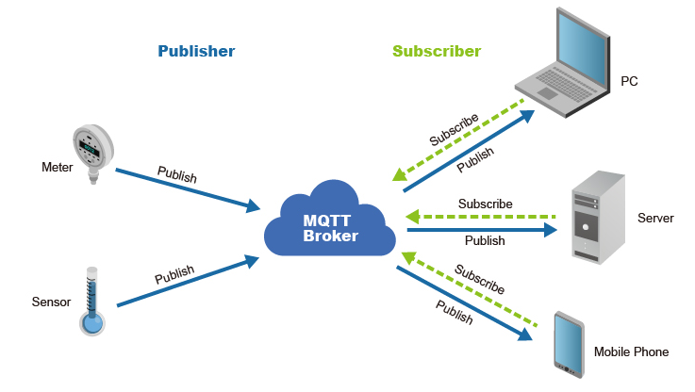
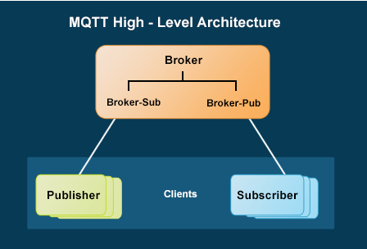
MQTT
MQ Telemetry Transport
"MQ" came from the IBM 'MQSeries' product line and is "Message Queue“
MQTT Broker and Client (Pub/Sub)
Publish to or Subscribe to a “Topic”
E.g. groups.io, twitter, discord
MQTT uses text messages (anything). You parse it

Slide 6
MQTT & the morse tutor
Client Connects to MQTT Broker
Uses DNS hardcoded name
Subscribes to a topic (I refer to it as a room)
Paddles/Key generates a character that is “published” to a topic
Every client that subscribes to the topic receives the message
Publisher ignores messages it sends
Publish to “morsetutor”
Subscribe to “morsetutor”
Publish to “morsetutor”
Subscribe to “morsetutor”
MQTT Broker
Publish “cq”
Subscribe “cq”
MQTT Client
MQTT Client

Slide 7
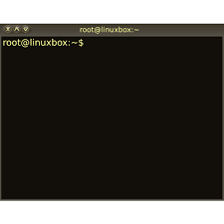

DEMO
Don’t have 2 W8BH Morse Tutors to Test
Subscribe to
“morsetutor”
Publish to
“morsetutor”
MQTT Broker
Publish to “morsetutor”
Subscribe to “morsetutor”
Publish to “morsetutor”
Subscribe to “morsetutor”
MQTT Client
Outstanding (TODO):
Live test with another morse tutor
Add configuration parameters
Figure out distribution
MQTT Client

Slide 8


